Slide 1

by HomeCoders
"A decentralized healthcare facility dedicated to providing high- quality, patient-centered care to our community."

Slide 2
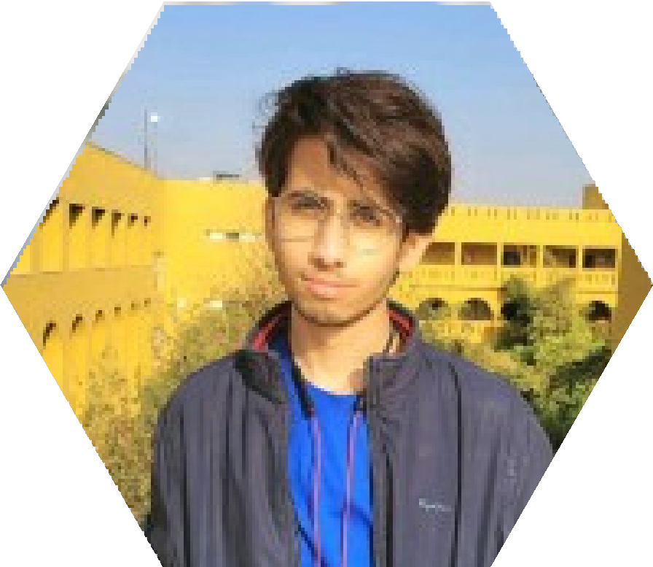

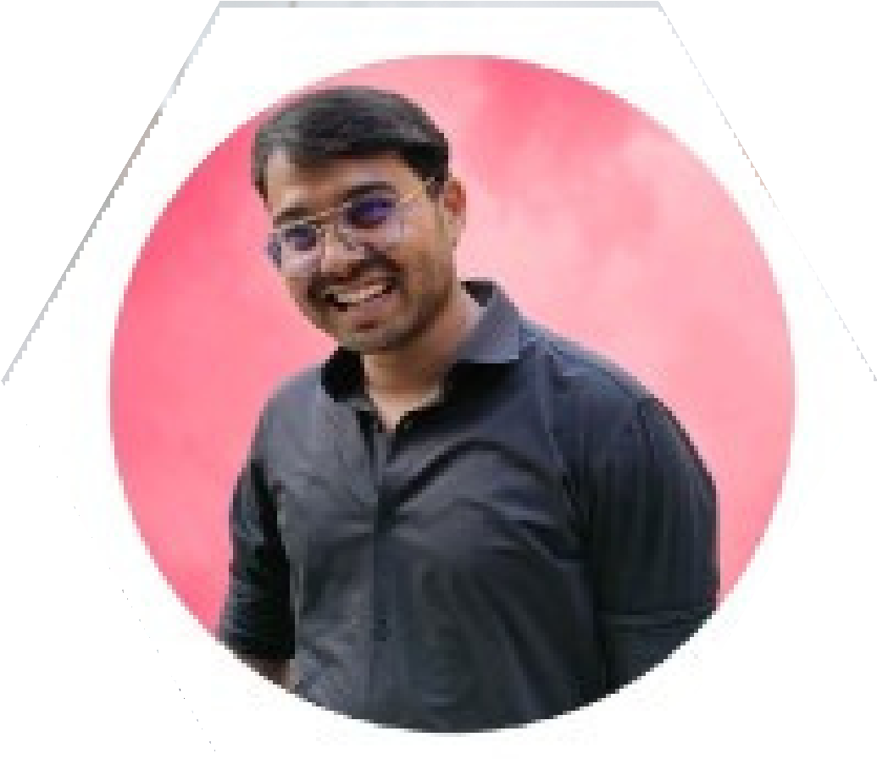
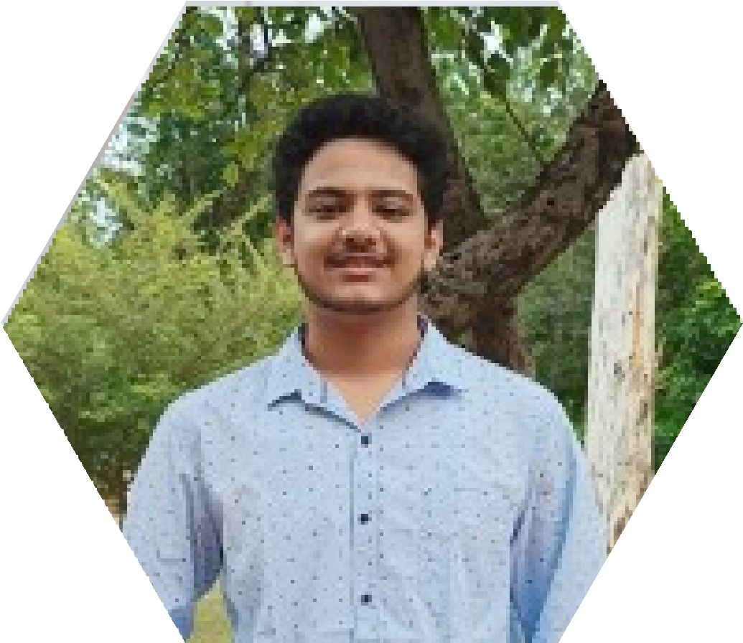
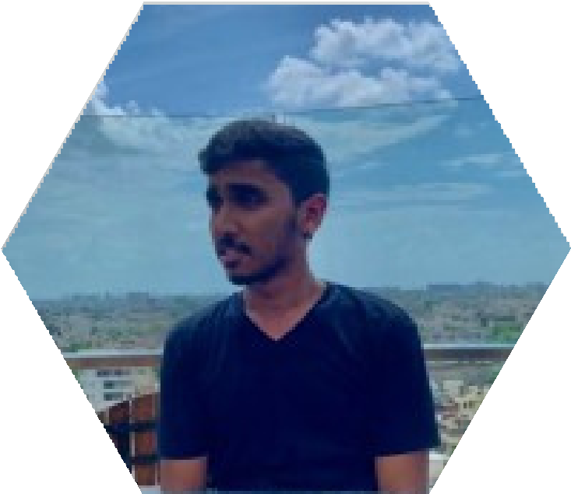

Our Team:
ANEERBAN
SAHA
SAMEER
MADHAV D.
ANKIT
KUMAR
AYAN
PANCHARIYA
SARTHAK
GARG
ANKIT
GUPTA

Slide 3
Problem Statement.
The increase in population has led to appointment management process being more confound as the relative number of doctors per patient increases and keeping appointments collision free becomes difficult. Not being able to choose a correct specialist leads to a vicious cycle where ignored or delayed diagnostics of an ailment makes the patient more dependent on doctor's check-up.
The patients get to choose from multiple healthcare professionals in their locality and get access to genuine and verified reviews.

Slide 4
Problems we aim to solve with implementation of Med-x:
Non-avaibility
Non-Availability of doctor causes wastage of patient's time. Causes fatal harm to patients in emergency situations.
Double Booking
Overlap in Doctors appointments often leading to extra waiting time.
Comparison
Difficult to compare specialists and pick the one best suited to you.

Slide 5
What we provide?
1.
Efficient allotment and seamless management of appointments.
2.
With the use of blockchain, we tend to avoid collisions and the data remains transparent.
3.
Doctors can check upon the Health Records as well as previous medical test result of the patients which ensures better diagnosis.
4.
Blockchain ensures security as once the data is deployed on the blockchain it cannot be altered.

Slide 6
What we provide?
5.
Elimination of any aspects of human error through the use of scheduling software which ensures that there is no double booking and no overlap in any booking/appointment.
6.
Cancel and move appointments seamlessly through the manage appointments section. (subject to availablity and cancellation fees as per the terms and conditions)
7.
if your preffered time slot is not available you can book a different time slot and request the preffered time slot if it becomes available.
8.
Pick from the many specialists signed up to the platform and chose the best one most suited to you, get genuine and verified reviews to help you in making the decision.

Slide 7

Why WEB 3.0
No conflicts as all the transactions are publically available.
No middle man interaction is needed and all actions are executed by smart contracts in a safe and secure manner.
Minimal maintenance cost.

Slide 8
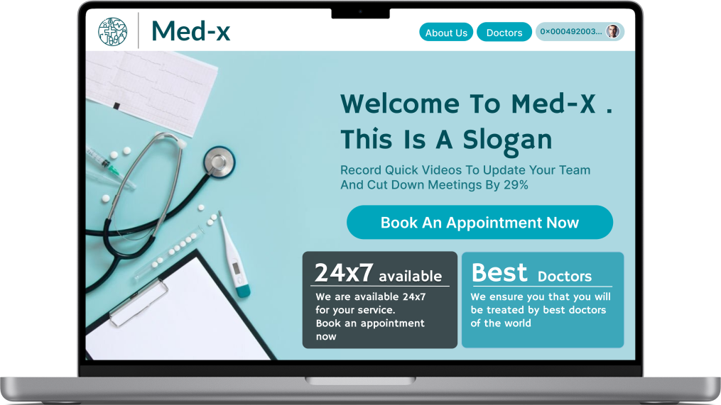
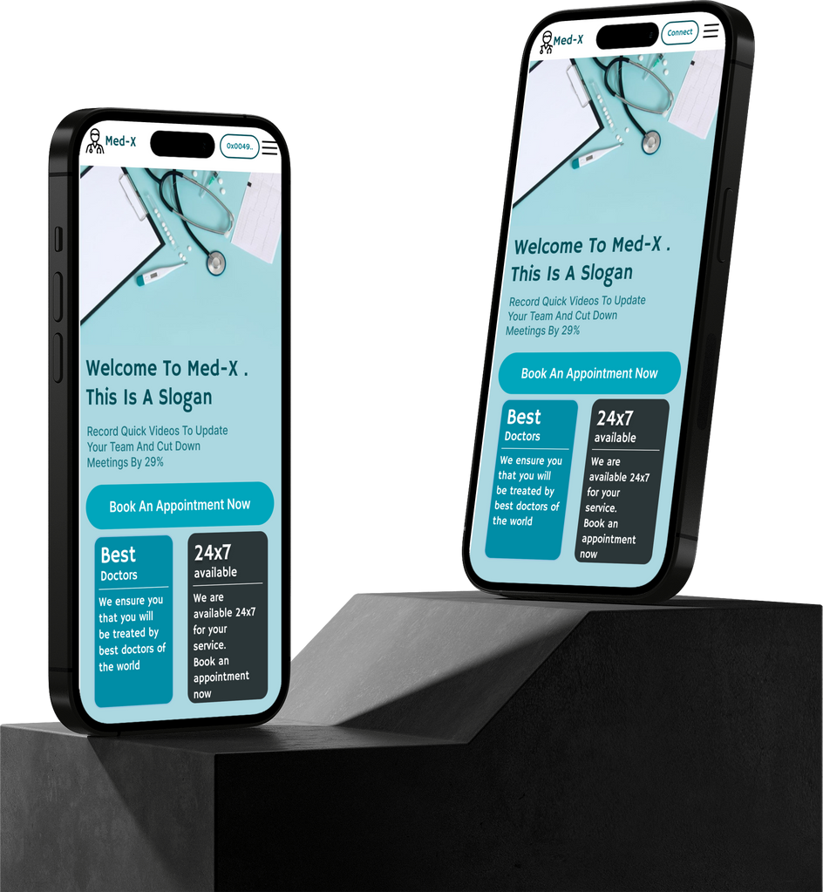
UI/UX:
Home page and Login

Slide 9
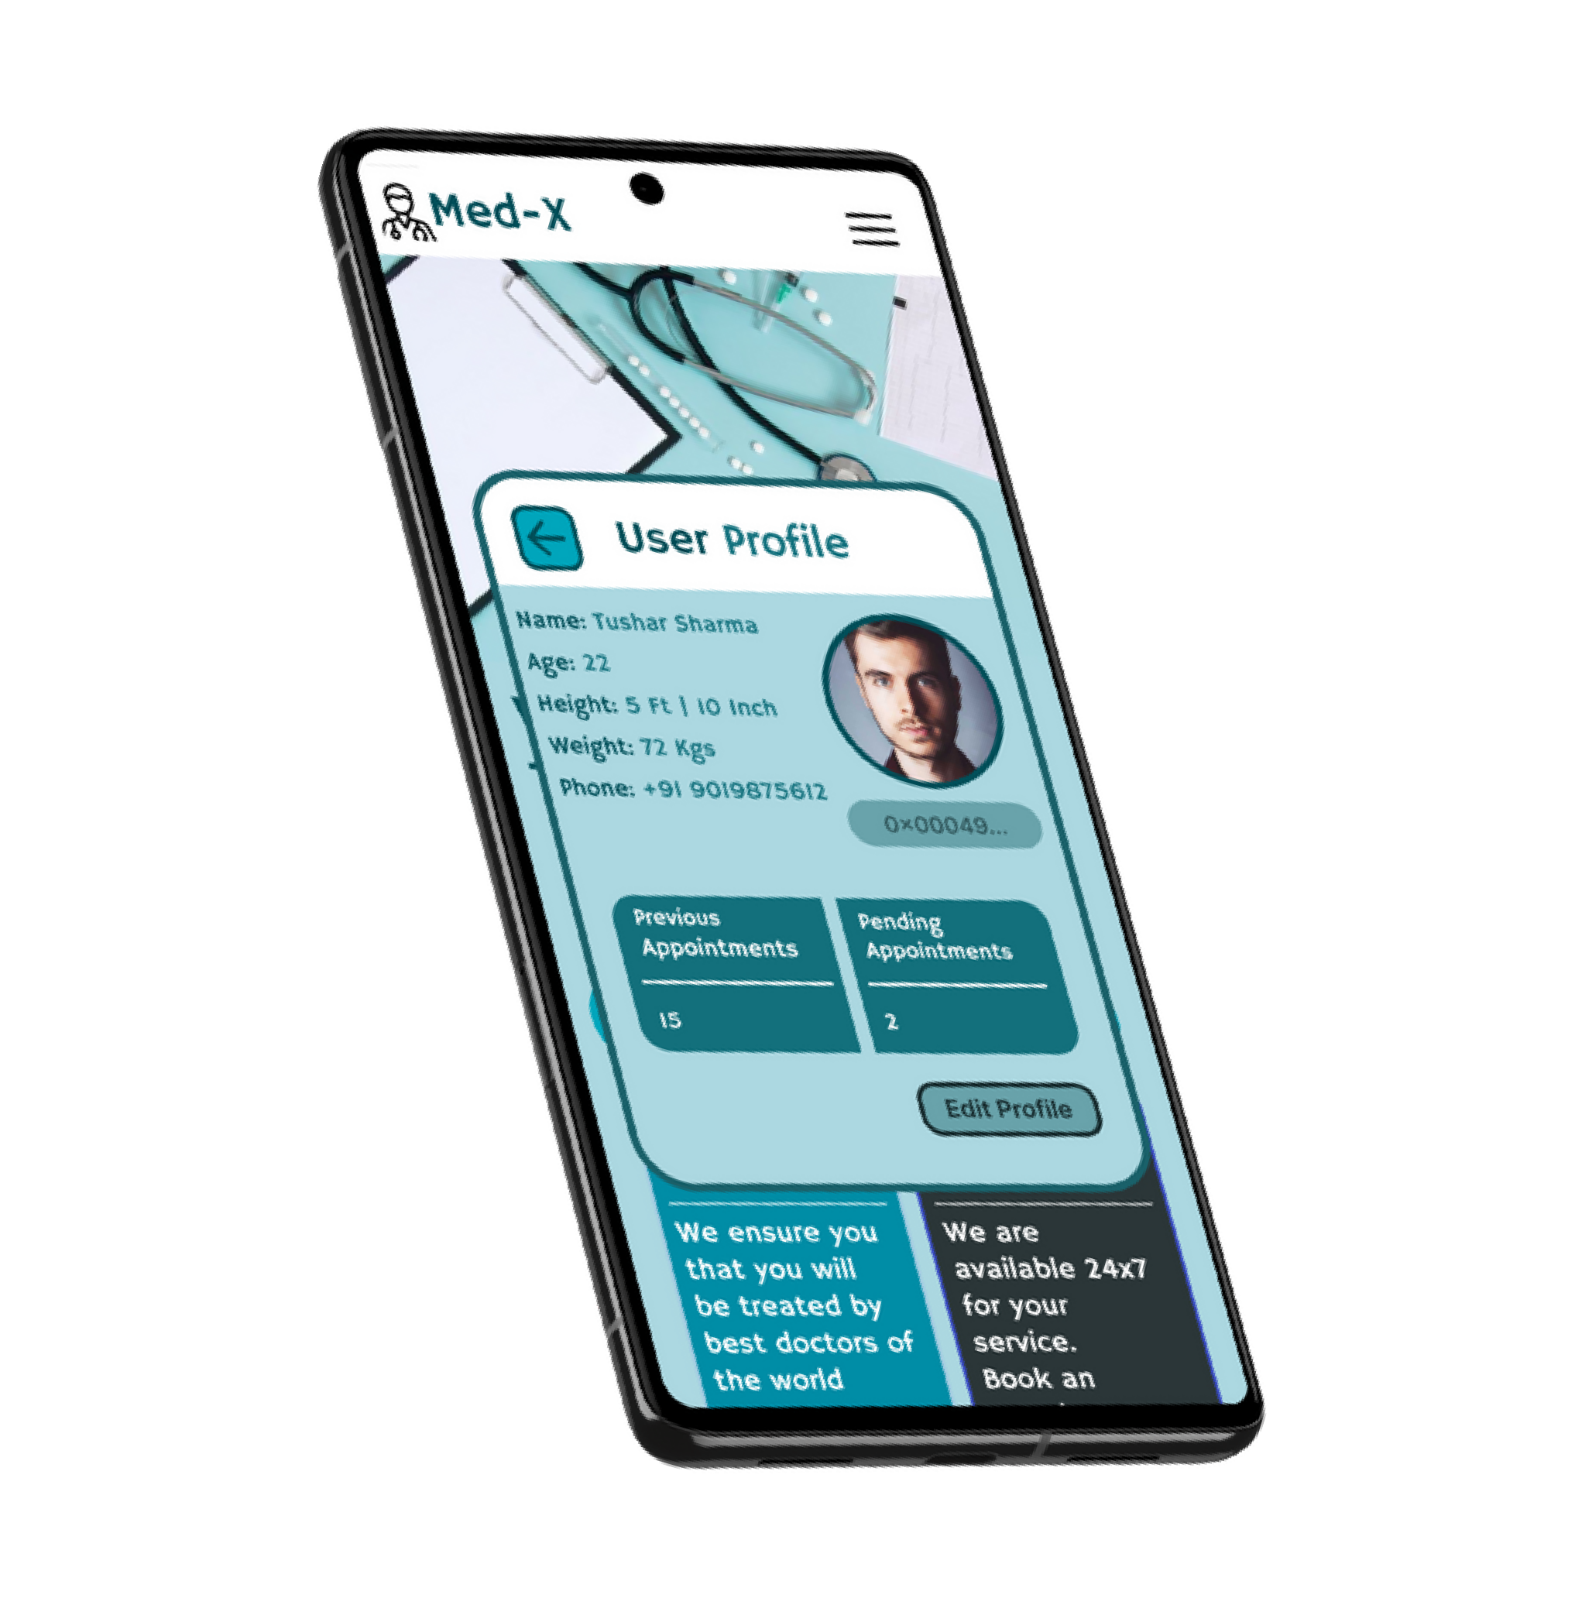
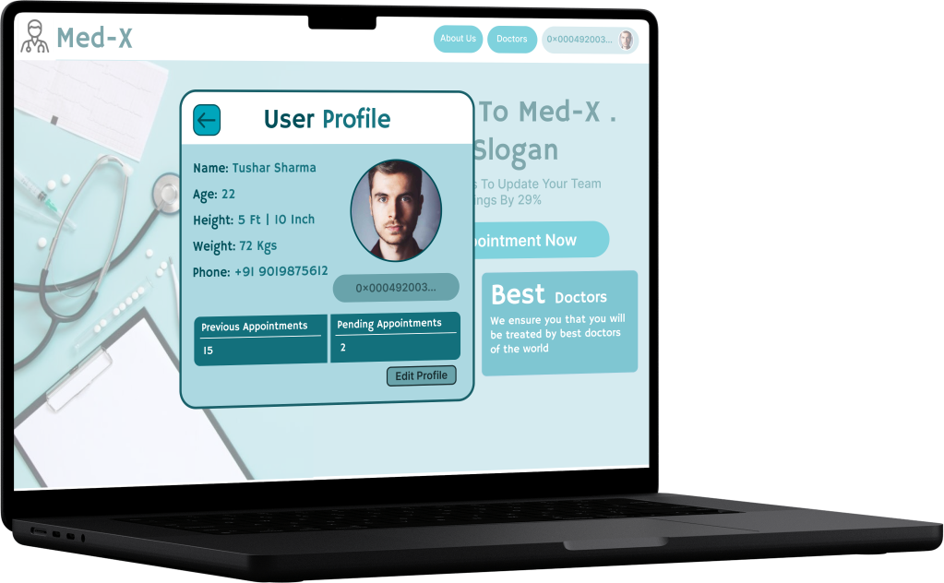
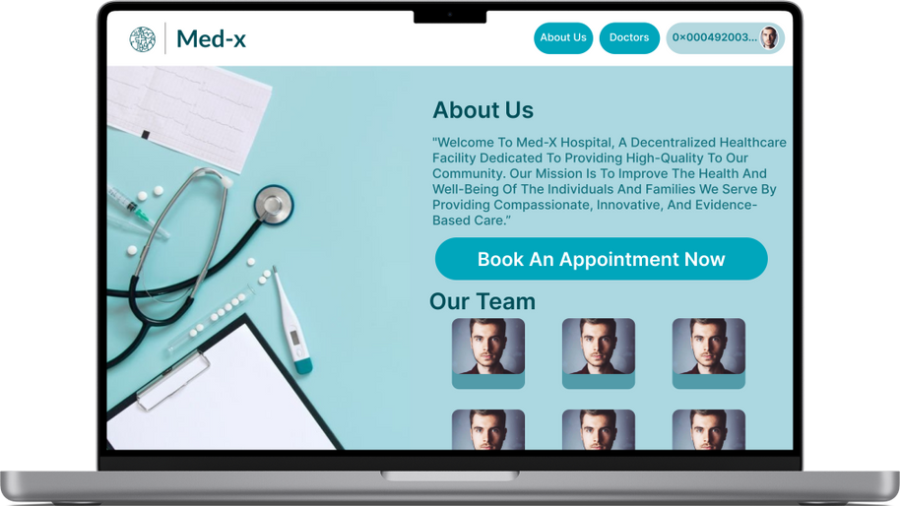
_{U}U_{se}se_{r} r_{P}p_{ro}ro_{fi}f_{l}i_{e}le

Slide 10
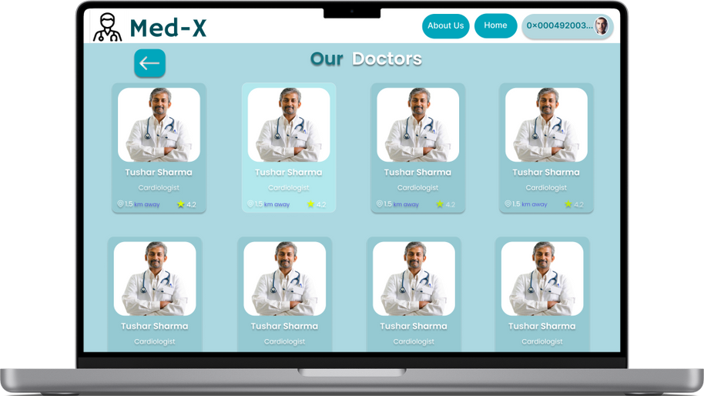
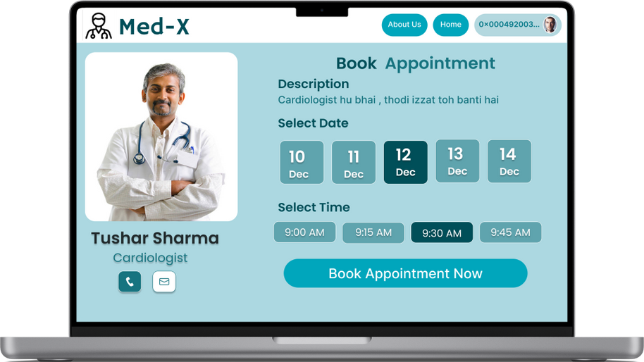
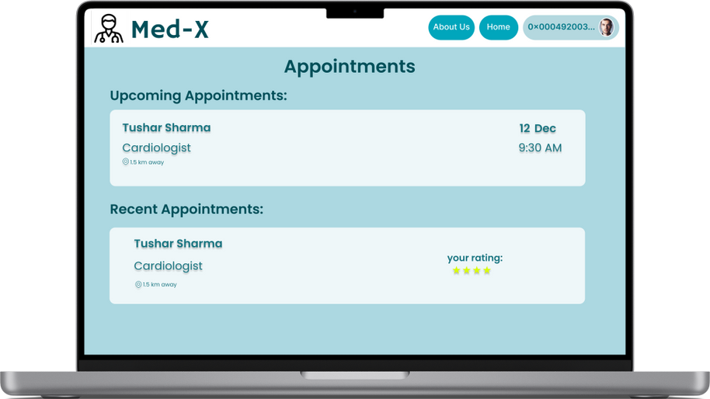
Choose from the best healthcare professionals
Make an appointment
Manage your appointments

Slide 11
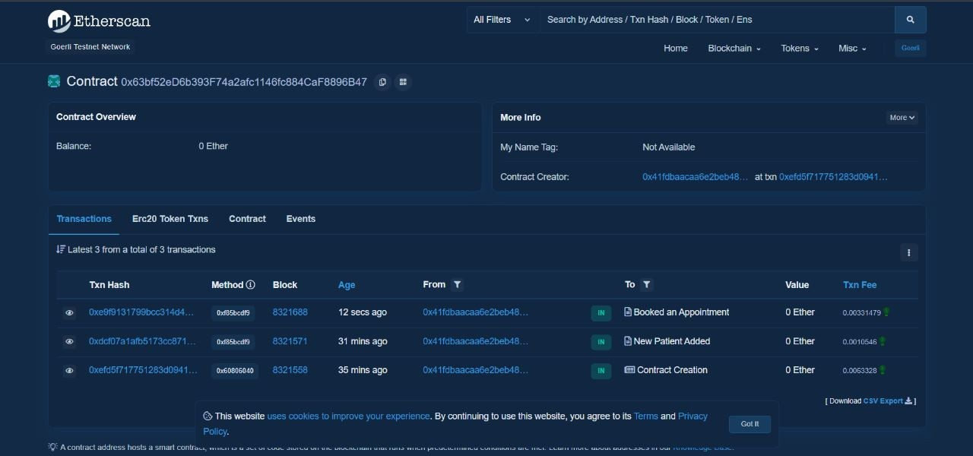

Public Transaction History on EtherScan

Slide 12


Teck Stack:

Slide 13

Business Model:
The platform makes it's revenue through the small transaction fees which is charged directly upon making the payment to the doctor through cryptocurrencies.

Slide 14
Target Audience:
The product targets the healthcare professionals and patients looking for seamless and hassle free appointment booking backed by security of Blockchain.

Slide 15

Future Prospects:
Access to complete medical history of the patient stored
securely with restricted access, the patient solely manages access to the health records and medical reports.
Updating an appointment if the patient is unable to get a booking at the preferrd time slot , they can opt for update booking if the slot desired becomes available due to
cancellation of another appointment.

Slide 16
THANK YOU

